Slide 1
Designing Classes
Identifying classes and objects
Structure and content of classes
Instance data

Slide 2
Classes and Objects
Simple programs can be written using classes from libraries, in Java from the Java API
Programs can also use classes that we write ourselves
The class that contains the main method is just the starting point of a program
True object-oriented programming is based on defining classes that represent objects with well-defined characteristics and functionality

Slide 3
Classes and Objects
An object has a state, defined by the values of its attributes
The attributes are defined by the data associated with the object's class (instance data)
An object also has behaviors, defined by the operations associated with it
Operations are defined by the methods of the class

Slide 4
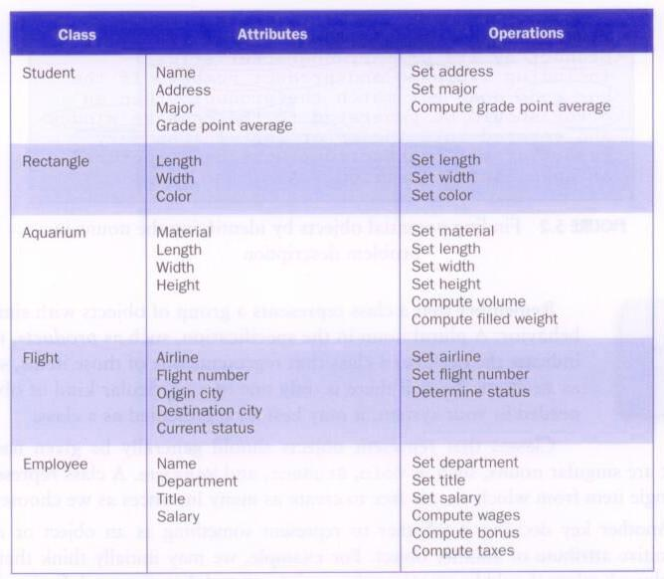
Classes and Objects

Slide 5
Identifying Classes and Objects
A class represents a group (classification) of objects with the same behaviors
Generally, classes that represent objects should be given names that are singular nouns
Examples: Coin, Student, Message
A class represents the concept of one such object
We are free to instantiate as many of each object as needed

Slide 6
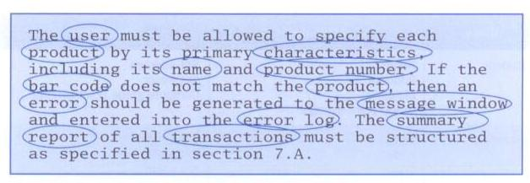
Identifying Classes and Objects
One way to find potential objects is by identifying the nouns in a problem description:

Slide 7
Identifying Classes and Objects
Part of identifying the classes we need is the process of assigning responsibilities to each class
Every activity that a program must accomplish must be represented by one or more methods in one or more classes
We generally use verbs for the names of methods
In early stages it is not necessary to determine every method of every class – begin with primary responsibilities and evolve the design

Slide 8
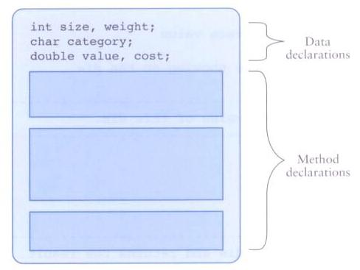
Anatomy of a Class
A class contains data declarations and method declarations

Slide 9
Anatomy of a Class
Consider a six-sided die (singular of dice)
Its state can be defined as which face is showing
Its primary behavior is that it can be rolled
We can represent a die in software by designing a class called Die that models this state and behavior
We’ll want to design it so that it's a versatile and reusable resource
Any given program will not necessarily use all aspects of a given class

Slide 10
public class Die
{
private final int MAX = 6; // maximum face value
private int faceValue; // current value showing on the die
public Die()
{
faceValue = 1;
}
public int roll()
{
faceValue = (int)(Math.random() * MAX) + 1;
return faceValue;
}
public void setFaceValue(int value)
{
if (value > 0 && value <= MAX)
faceValue = value;
}
public int getFaceValue()
{
return faceValue;
}

Slide 11
//-----------------------------------------------------------------
// Returns a string representation of this die.
//-----------------------------------------------------------------
public String toString()
{
String result = Integer.toString(faceValue);
return result;
}
}

Slide 12
public class SnakeEyes
{
public static void main(String[] args)
{
final int ROLLS = 500;
int num1, num2, count = 0;
Die die1 = new Die();
Die die2 = new Die();
for (int roll=1; roll <= ROLLS; roll++)
{
num1 = die1.roll();
num2 = die2.roll();
if (num1 == 1 && num2 == 1) // check for snake eyes
count++;
}
System.out.println("Number of rolls: " + ROLLS);
System.out.println("Number of snake eyes: " + count);
System.out.println("Ratio: " + (float)count / ROLLS);
}
}

Slide 13
The toString Method
Most classes should define a toString method
The toString method returns a character string that represents the object in some way
It is called automatically when an object is concatenated to a string or when it is printed using the println method

Slide 14
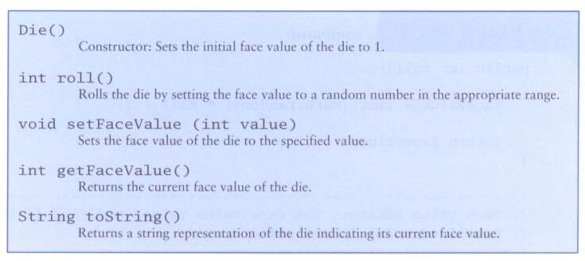
Anatomy of a Class
The primary difference between the Die class and other classes you've used is that the Die class is not part of the Java API

Slide 15
Constructors
As mentioned previously, a constructor is a special method that is used to set up an object when it is initially created
A constructor has the same name as the class
The Die constructor is used to set the initial face value of each new die object to one
We examine constructors in more detail later

Slide 16
Data Scope
The scope of data is the area in a program in which that data can be referenced (used) (inside the braces it was declared)
Data declared at the class level can be referenced by all methods in that class
Data declared within a method can be used only in that method
Data declared within a method is called local data
In the Die class, the variable result is declared inside the toString method -- it is local to that method and cannot be referenced anywhere else

Slide 17
Instance Data
The faceValue variable in the Die class is called instance data because each instance (object) that is created has its own version of it
A class declares the type of the data, but it does not reserve any memory space for it
Every time a Die object is created, a new faceValue variable is created as well
The objects of a class share the method definitions, but each object has its own data space
That's the only way two objects can have different states

Slide 18
Instance Data
We can depict the two Die objects from the SnakeEyes program as follows:
Each object maintains its own faceValue variable, and thus its own state
die1
faceValue
5
die2
faceValue
2

Slide 19
Encapsulation
We can take one of two views of an object
internal - the details of the variables and methods of the class that defines it
external - the services that an object provides and how the object interacts with the rest of the system
From the external view, an object is an encapsulated entity, providing a set of specific services
These services define the interface to the object

Slide 20
Encapsulation
One object (called the client) may use another object for the services it provides
The client of an object may request its services (call its methods), but it should not have to be aware of how those services are accomplished
Any changes to an object's state (its variables) should be made by that object's methods
We should make it difficult, if not impossible, for a client to access an object’s variables directly
That is, an object should be self-governing

Slide 21
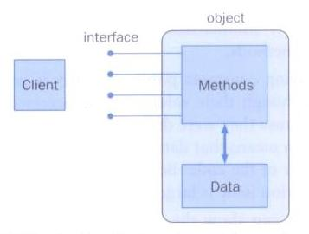
Encapsulation
An encapsulated object can be thought of as a black box – its inner workings are hidden from the client
The client invokes the interface methods of the object, which manages the instance data….

